Slide 1
Lightweight ML Framework Performance
Kyle Hoffpauir and Adam Kolides

Slide 2
Introduction
The Internet of Things is a semi-decentralized infrastructure for computing in the modern age
Users place devices on the “edge” (ie. a smart thermostat) and these devices communicate with the cloud, passing data it collects
The cloud now gets an (in theory) infinitely scalable source of novel data to train models on and perform whatever their applications do.
In the traditional IoT model, most (if not all) computations happen in the cloud, while the edge devices act as a UI/UX and data collection point

Slide 3
Traditional IoT drawbacks
All computations happening in the cloud limits the power of these networks significantly, as they are relying on large data centers in far off locations to process their data.
Sending this data causes in-flight security problems and latency problems
The amount of data causes computational resource sharing problems for the cloud
What if we could make it so that we don’t have to send all our data to the cloud for computations

Slide 4
Edge Computing / Edge Intelligence
Instead of doing all the calculations in the cloud, a new paradigm emerges in Edge Computing
Edge computing leverages the massive amounts of data these IoT sensors can collect and has the devices preprocessing as they are entering the devices
The edge devices get a lightweight copy of a pre-trained model from the cloud.
An AI/ML algorithm that’s been trained on similar data as a baseline
These lightweight models can then be used to predict on this novel data, eliminating the need to transfer the data from the cloud to the edge devices

Slide 5
How it works
Cloud data center
Edge Device
Edge Device
predictions
predictions
Edge Device
Edge Device
NOVEL DATA

Slide 6
How it works
Cloud data center
Edge Device
Re-trained lightweight models
Re-trained lightweight models
Edge Device
Edge Device
Edge Device
NOVEL DATA

Slide 7
What we did
In an effort to explore and implement the principles of edge intelligence, we aimed to create a system which would be able to use lightweight ML frameworks and perform predictions with little overhead
We created a pre-trained neural network using two different frameworks and ported them to their lightweight equivalents
Then, using these lightweight models, we tested them on a test set from the MNIST digit dataset and a handful of created digits
We measured the accuracy, CPU utilization, and runtime of all the lightweight models

Slide 8
Materials and Methods
MNIST Dataset
Python
Neural Networks
Tensorflow and Tensorflow Lite
MXNet
ONNX

Slide 9
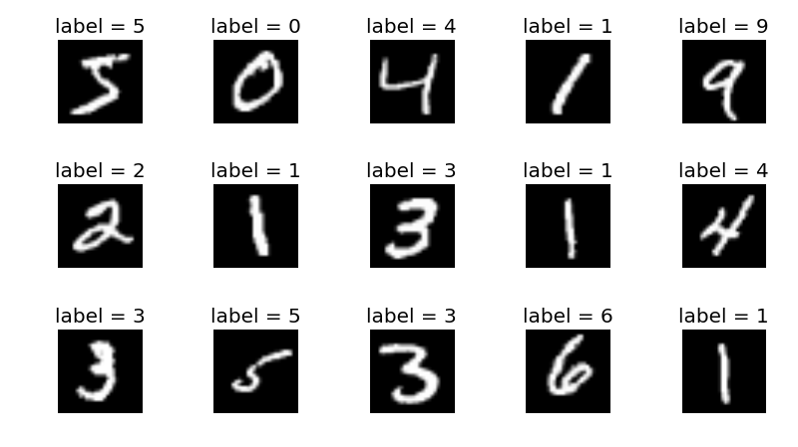
MNIST Dataset
Digits dataset created by NIST for classification
Handwritten digits in 28x28 pixel format
Neural Network focuses on the lightness / darkness of each pixel
Digit classification is a classic neural network problem
https://towardsdatascience.com/improving-accuracy-on-mnist-using-data-augmentation-b5c38eb5a903

Slide 10
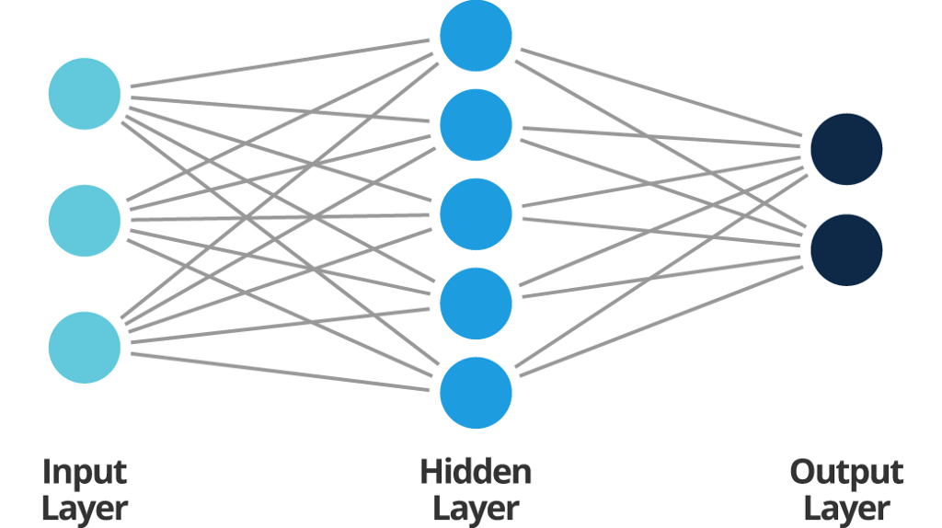
Neural Networks
Neural networks are a machine learning technique that use weighted vectors to convert a series of inputs into a classified output
For example, the input would be a 28x28 grid of the darkness of pixels on the digit image.
The NN would take each pixel and based on it’s proximity to other pixels of similar/different darkness, create a line from input to a single output.
This classifies the sequence of pixels as a digit (0-9)
https://towardsai.net/p/machine-learning/how-to-build-and-train-your-first-neural-network-9a07d020c4bb

Slide 11
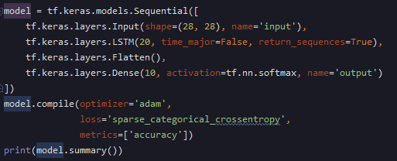
Tensorflow + Tensorflow Lite
Tensorflow is a python library which is designed to help engineer ML applications.
Tensorflow was used due to it’s Neural Network building tools and ability to port into a lightweight version of itself fairly easily

Slide 12
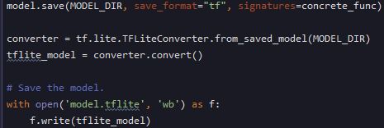
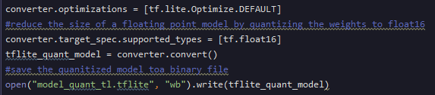
Tensorflow lite conversion
Converting a pre-trained model into
Tensorflow lite is fairly straightforward.
Simply use the TFLiteConverter and
save the model
TFLite also comes with a nice
optimization feature which will
Further reduce the size of a
Tflite model.

Slide 13
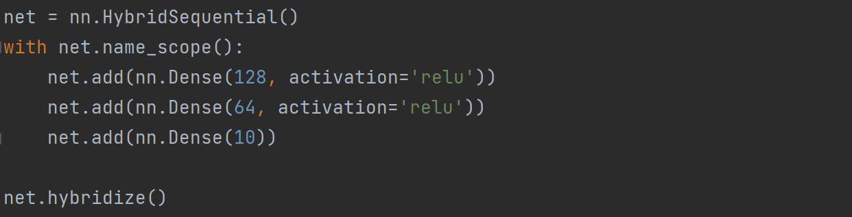
MXNet
MXNet is a software framework which is designed to implement deep learning
MXNet is a pretty heavy framework but it can be converted to ONNX

Slide 14
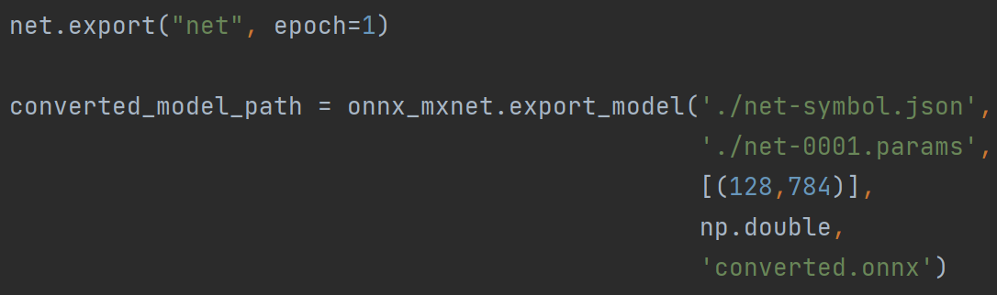
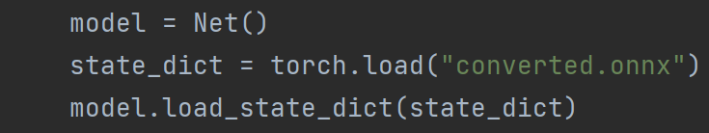
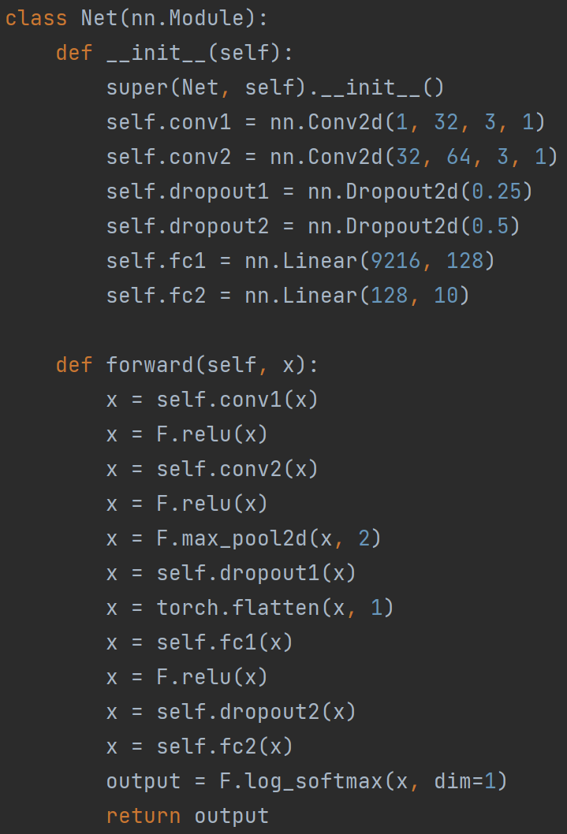
ONNX conversion
MXNet conversion to ONNX was straightforward. We took the created MXNet model and exported it to an ONNX model, using saved parameters
Tricky thing was getting the ONNX model to run with our test images

Slide 15

Demonstration

Slide 16

Novel set results
TFLite: 0
ONNX: 0

Slide 17

Novel set results
TFLite: 2
ONNX: 0

Slide 18

Novel set results
TFLite: 1
ONNX: 4

Slide 19

Novel set results
TFLite: 2
ONNX: 2

Slide 20

Novel set results
TFLite: 2
ONNX: 2

Slide 21

Novel set results
TFLite: 2
ONNX: 2

Slide 22

Novel set results
TFLite: 2
ONNX: 3

Slide 23

Novel set results
TFLite: 7
ONNX: 7

Slide 24

Novel set results
TFLite: 2
ONNX: 7

Slide 25
Results
Model | Accuracy | Cpu Utilization | Runtime (ms)
Tensorflow Lite | 100% 55.55% (small) | 50% | 18.46
MXNet | 100% 66.66% (small) | 54% | 27.7

Slide 26
Conclusions
Best model is Tensorflow Lite
Lower accuracy on novel dataset, but on large test set the accuracy was high and comparable to ONNX
The low accuracy on the novel data could be a result from a relatively low sample size on this dataset
Runtime and cpu utilization of the tensorflow model was lower, and on low power IoT hardware, this takes priority
Overall, the tensorflow model performed poorly on the handmade digit training and evaluation, but outperforms ONNX in the long run

Slide 27
Future Work
Use actual IoT sensors and edge devices (raspberry pi) to do something like computer vision with the lightweight ML framework
Tweak neural network for accuracy + results
Adding more layers and back propagation may increase the power of the network
More models
There are many more lightweight ML models that could be used
Bigger testing dataset
More precise accuracy percentage

Slide 28
References
Jamal Bazi et al. Machine learning-enabled internet of things (iot): Data, applications, and industry perspective. Electronics 11.17 (2022): 2626, 2022.
Shuiguang Deng et al. Edge intelligence: The confluence of edge computing and artificial intelligence. IEEE Internet of Things Journal 7.8 (2020): 7457-7469, 2020.
Hafizur Rahman and Md. Iftekhar Hussain. A light-weight dynamic ontology for internet of things using machine learning technique. ICT Express, 7(3):355–360, 2021.
G.P. Sajeev and M.P. Sebastian. Building semi-intelligent web cache systems with lightweight machine learning techniques. Computers Electrical Engineering, 39(4):1174–1191, 2013.
Cong Wang, George Papadimitriou, Mariam Kiran, Anirban Mandal, and Ewa Deelman. Identifying execution anomalies for data intensive workflows using lightweight ml techniques. In 2020 IEEE High Performance Extreme Computing Conference (HPEC), pages 1–7, 2020.

